Slide 1
Carter School Sensory Walk
Team 21:
Reva Scharf, Jian Tan, Maya Saint Germain,
Jesse Leinbach, Austin Schiller, Aidar Aidymbekov
Notes:
Hello everyone, thank you for joining us this afternoon. We’re excited to share with you our

Slide 2
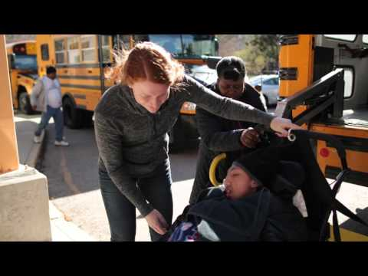
The Carter School
https://youtu.be/lzR40cV0dTo
Notes:
Austin - The Carter School is a Boston Public School for people with mental and physical disabilities. We thought the best way to represent who they are and the importance of what they do there was with this video.

Slide 3
Project Overview
To create a wall-mounted installation for the Carter School to track, store, and motivate a student’s movement progress through the use of:
Audio and light stimuli for positive reinforcement
Number Sense
To automate the physical therapy program’s data collection methods
Notes:
Each week, Barbara, the physical therapist at the Carter School, has a program she does with the students to see how far they can progress down the hallway on their own. She tasked us with creating a system that would give the students auditory and visual stimuli for the task, to help encourage them down the hall. The system we created is a 21 foot number line with the numbers 0-21. The installation will also help the physical therapists to collect data on the students’ progress and keep track of their individual goals.

Slide 4
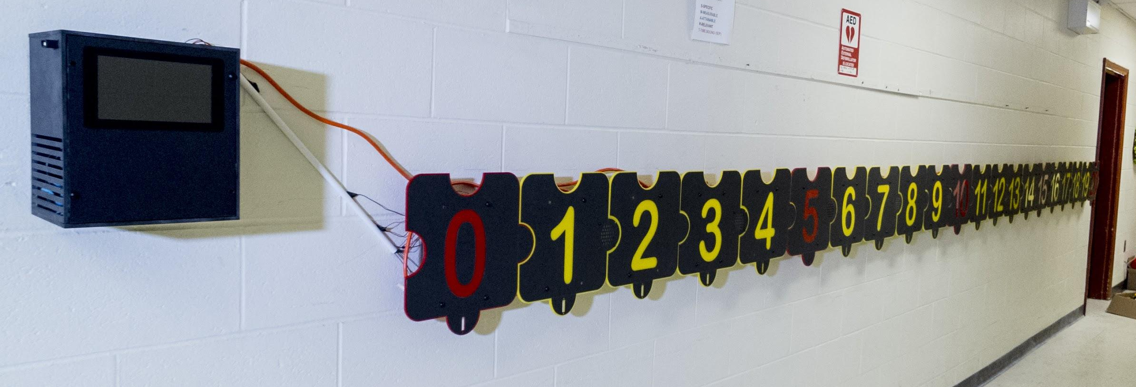
Notes:
Our finished system installed!

Slide 5
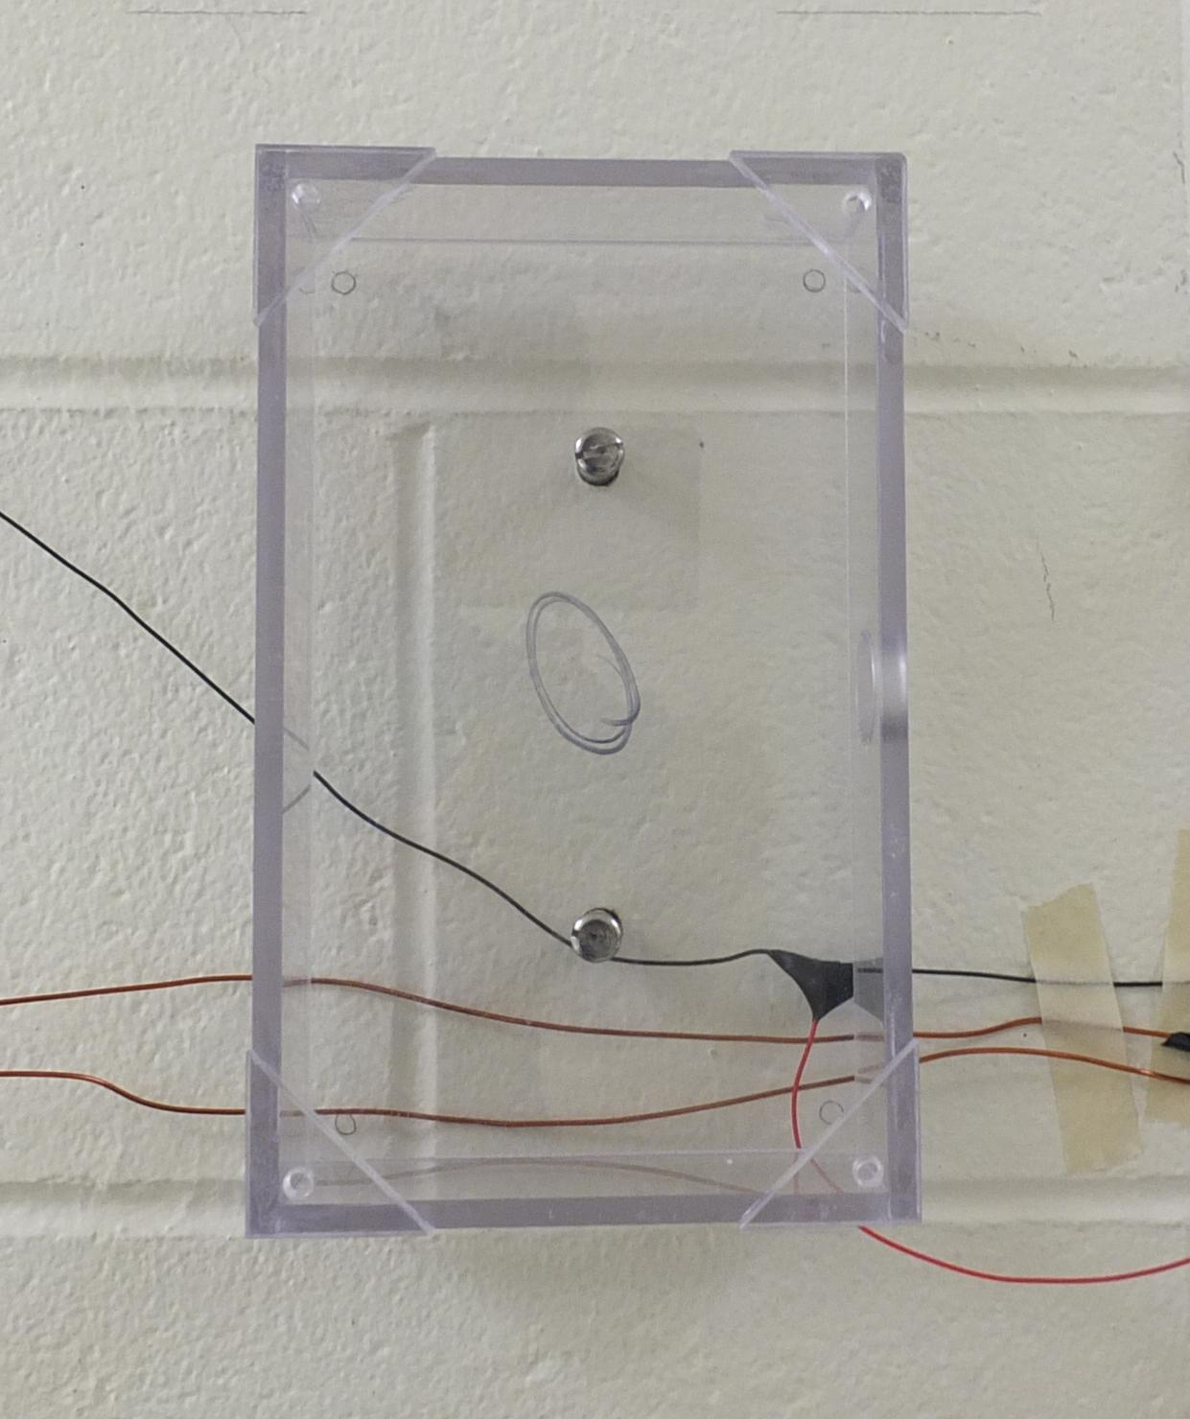
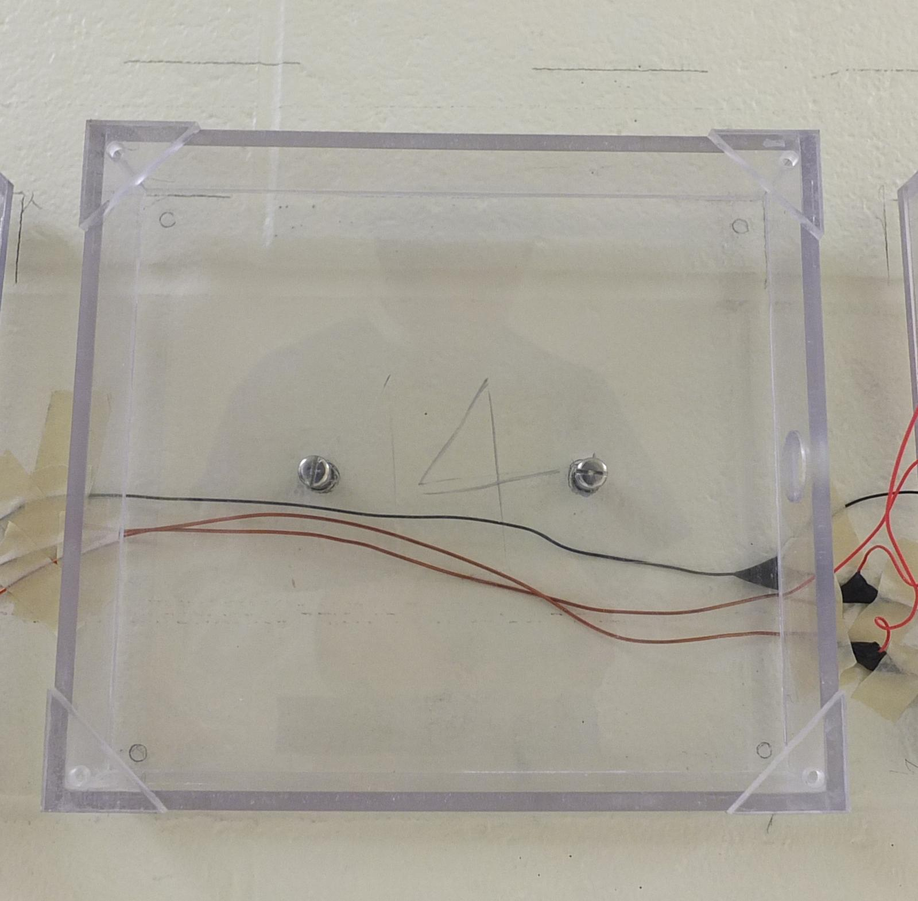
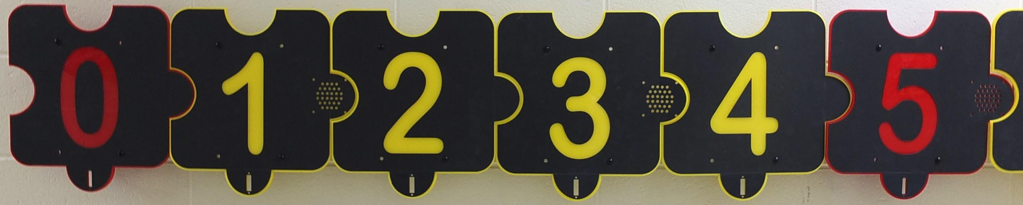
Panel Housing
Colors
Design
Puzzle piece shape
Notes:
Our 21 ft long system has numbers 0 through 20 panels, each 1ft x 1ft.

Slide 6
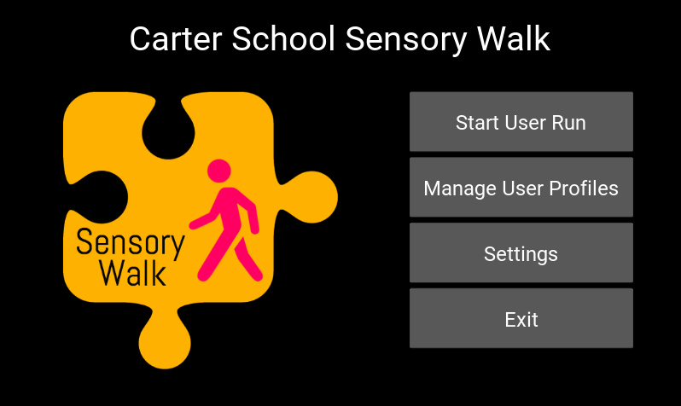
User Interface
Basic functionalities
Add user
Delete user
Running system
Data storage

Slide 7
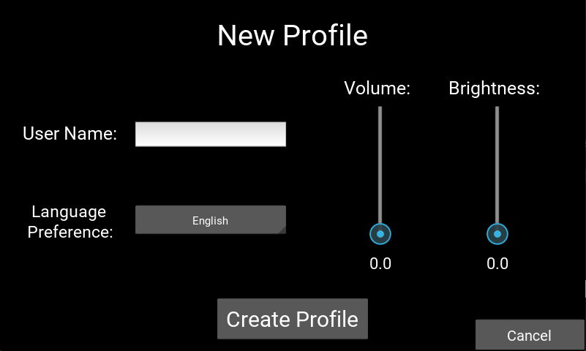
Preferences
Volume
Brightness 11 languages

Slide 8
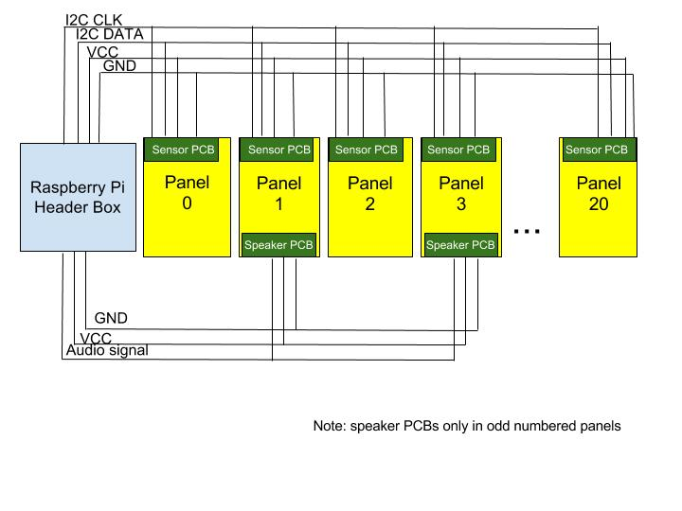
Communication System
Unidirectional motion detection
I2C panel communication
MSP430 microcontrollers to Raspberry Pi master
Notes:
At the core of this system is the unidirectional motion detection
As Reva said/mentioned, the system is headed by a Raspberry Pi. Inside each of the panels is an MSP430 microprocessor that communicates with the touchscreen and Raspberry Pi master through an I2C protocol. This allows for panel to panel communication orchestracted

Slide 9
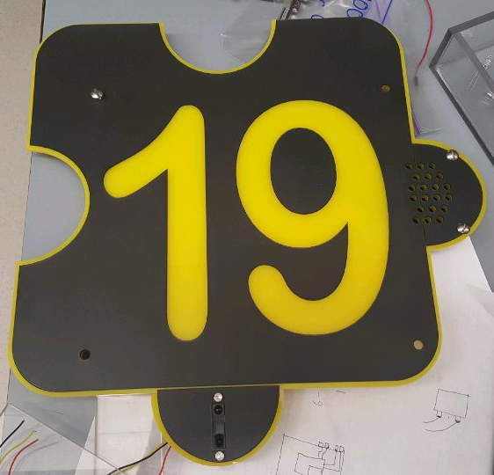
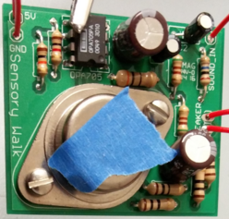
Jian - Electronics
Visual and auditory feedback
Speaker circuits
LED Circuits
Power analysis
Speaker
IR Sensor
Notes:
So to implement the positive auditory and visual feedback of the system, we created speaker amplifier circuits and LED driver circuits. Together, they are paired with an infrared sensor which sets them off. So at every foot, we have a full system where the sensor tells the MSP430 that someone's there and then the LEDs light up and the speaker announces the number in the appropriate language.
We’ve also decided to use two separate power supplies to prevent noise from traveling between the two separate digital and analog PCBs.

Slide 10
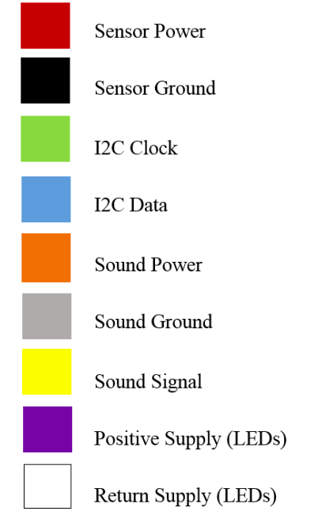
Jesse - PCBs
Connection and components
Speaker and sensor PCBs
Modularity for easy replacement
Notes:
Modularity through replacement - if anything breaks, each PCB is a separate piece that can be easily replaced. By just switching out connection wires, our product can be a permanent installation in the school.
Speaker and sensor PCBs being separate allows the user to only replace the part of the system that is broken

Slide 11
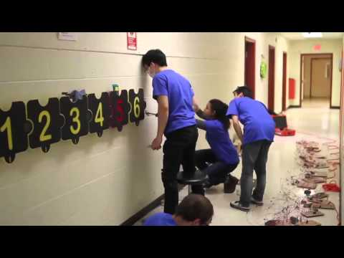
Installation + Operation
Notes:
The system was mounted on a 24 foot stretch of hallway at the Carter School. Each of the polycarbonate boxes are anchored to the cinderblock wall. The number panels are screwed into the boxes in numerical order to form a number line. The touchscreen display is at the head of the system, by the number 0 panel.
And here is our system being tested by physical therapist at the School

Slide 12
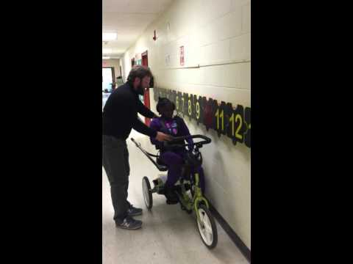
Installation + Operation

Slide 13
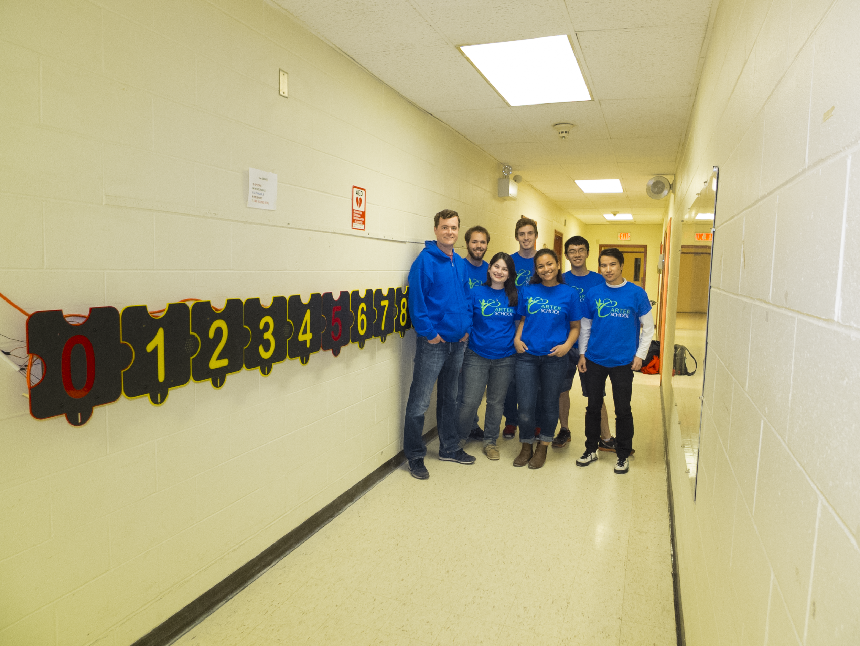
Concluding Remarks
“This project has a clear use for every single student in our school as a result of its design. We have students that will use the sensory walk to learn counting sequences from 0-20...We have many students that will use it to motivate them to travel independently in their wheelchair, gait trainer, or adapted bicycle all while recording the student’s progress over time. It truly is a project that has been universally designed for all students at the Carter School, and is something that does not exist on the market.”
-Mark O’Connor
Principal of the Carter School

